Slide 1
Introduction about the company
Name of the Company : Archer Print Innovations
Introduction :
This is a gift shop which prints customized product as per the requirements of the customer.
The products in this company are mainly categorized as :
Birthday Gifts
Anniversary Gifts
Customized Gifts
There are wide varieties of products at reasonable rates

Slide 2
Task assigned by the company
We have been assigned the task to create a website for this gift shop.
We have to first design the website and then implement it.

Slide 3
Technology/Platform Used
Languages Used :
HTML 5
CSS 3
Bootstrap 4
Javascript
Platform Used :
Visual Studio Code
Chrome Browser

Slide 4
Details of work done
Completed the designing part.
Implemented the work according to design.
Created a Navbar
Created Selection Bar
Displayed products using cards and carousel
Provided Add to cart method
Created different web pages according to the categories
Created Footer

Slide 5
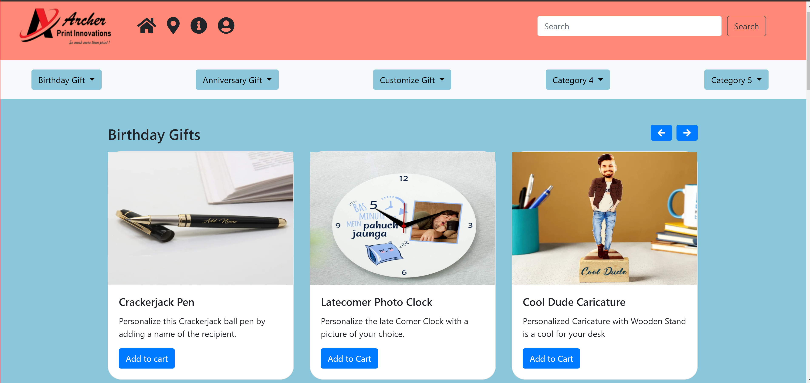
Screenshots of website
Home Page
Navbar
Selection bar

Slide 6
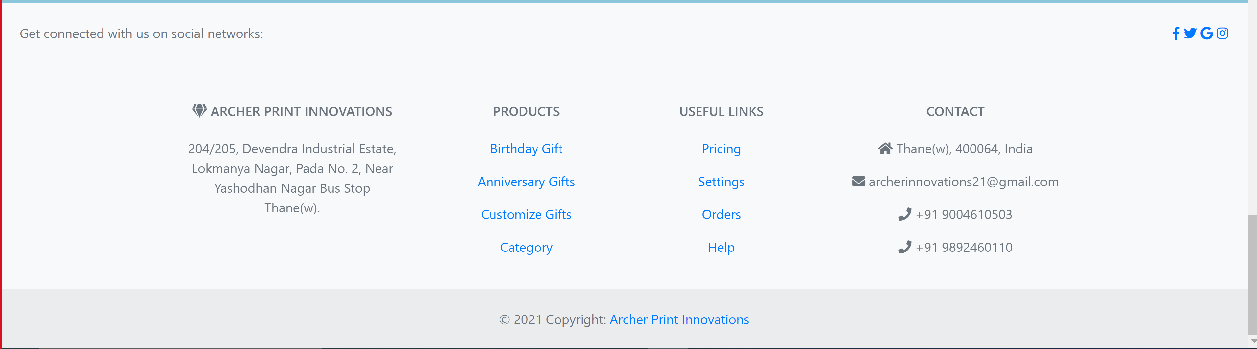
Screenshots of website
Footer

Slide 7
Learning/Experience
Learned to make the template of the website using HTML
Learned to add style to the website using CSS
Learned to make the website progressive using Bootstrap
Learned to add Action Performed on Buttons using JavaScript

Slide 8
Conclusion
By the end of this Internship we learnt how to make a website for a gift shop.
This was a real life example for us.
We learned how to make a responsive website using Bootstrap.
We learned about the usage of cards and carousel in our website to make it look good.
This website is made by Jeet Shah, Mit Shah, Tej Parmar.

